Slide 1




Marvel
vs
DC
Giulia Neves Monteiro

Slide 2



Which Company is better?
Marvel or dc?

Slide 3

Lets vote!

Slide 4

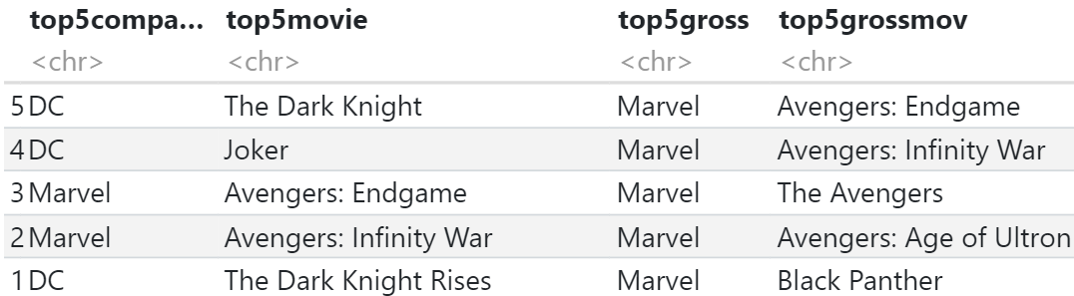
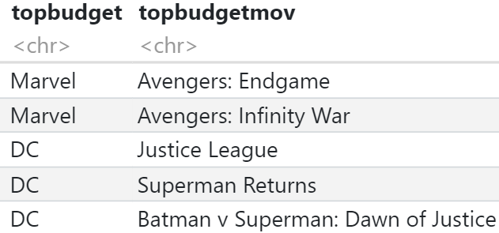

Top 5 Movies
1
2
3
4
5

Slide 5


Rating & Gross worldwide Averages

Slide 6
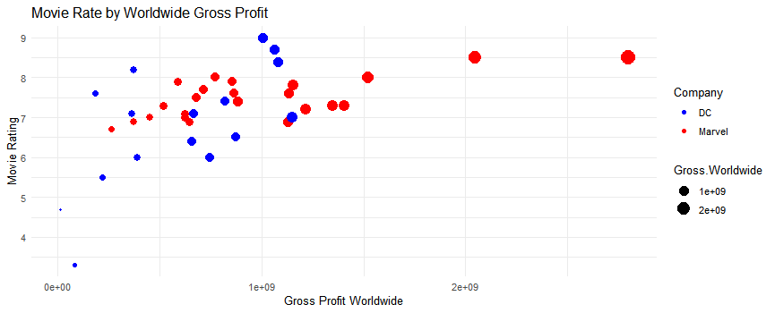

Slide 7
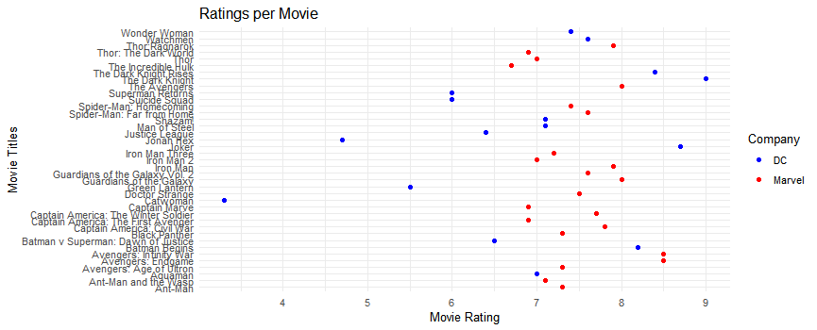
Marvel’s rating are clustered between 7-8

Slide 8
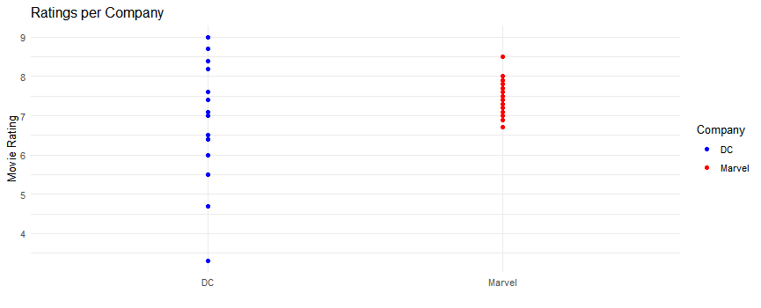
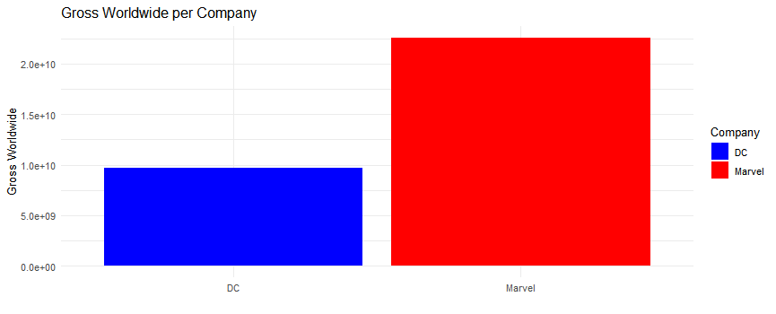
Marvel has more constant ratings
Marvel has much larger gross worldwide values

Slide 9

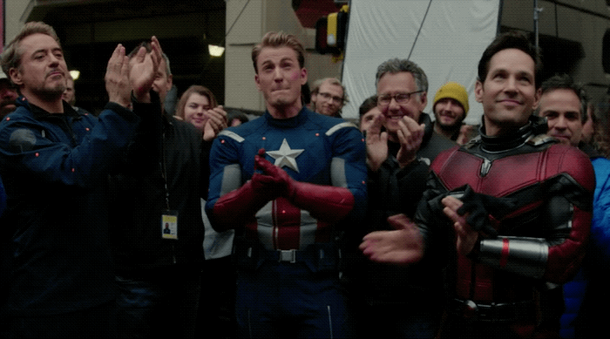
Marvel is better
Greater gross worldwide
Higher average ratings
Greater consistency in movie ratings

Slide 10


Thank you

